Slide 1
CARLI AI Symposium
CARLI Public Services Committee
April 15, 2025

Slide 2

Wrap Up Discussion
Notes:
Thank you for joining us, whether it was for a single session or the whole day.

Slide 3
Summary
AI Detection
Instruction
Vendor Tools
Discovery Tools
Evaluation Frameworks
Digital Preservation
Notes:
Today featured a series of presentations examining the evolving role of AI in libraries and education. The first session, sponsored by the CARLI Diversity, Equity, and Inclusion Committee, examined the use of AI detection tools in classrooms, discussing faculty reliance on these tools, their impact on student work, and offering alternative assignment strategies. The CARLI Instruction Committee followed with a session on the transformative power of AI in teaching, highlighting practical applications, challenges, and new research methods. After a break, the CARLI Commercial Products Committee addressed issues related to AI vendor tools in libraries, including copyright, fair use, data privacy, and policy implications. Following lunch, the CARLI Discovery Primo VE Committee critically assessed AI-powered discovery tools, exploring evaluation frameworks and strategies for adoption. The final presentation, led by the CARLI Preservation Committee, reviewed efforts to preserve trustworthy digital records, focusing on the outcomes of the InterPARES project and its current AI-enhanced phase, I Trust AI.

Slide 4
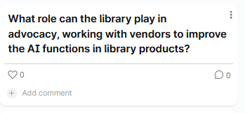
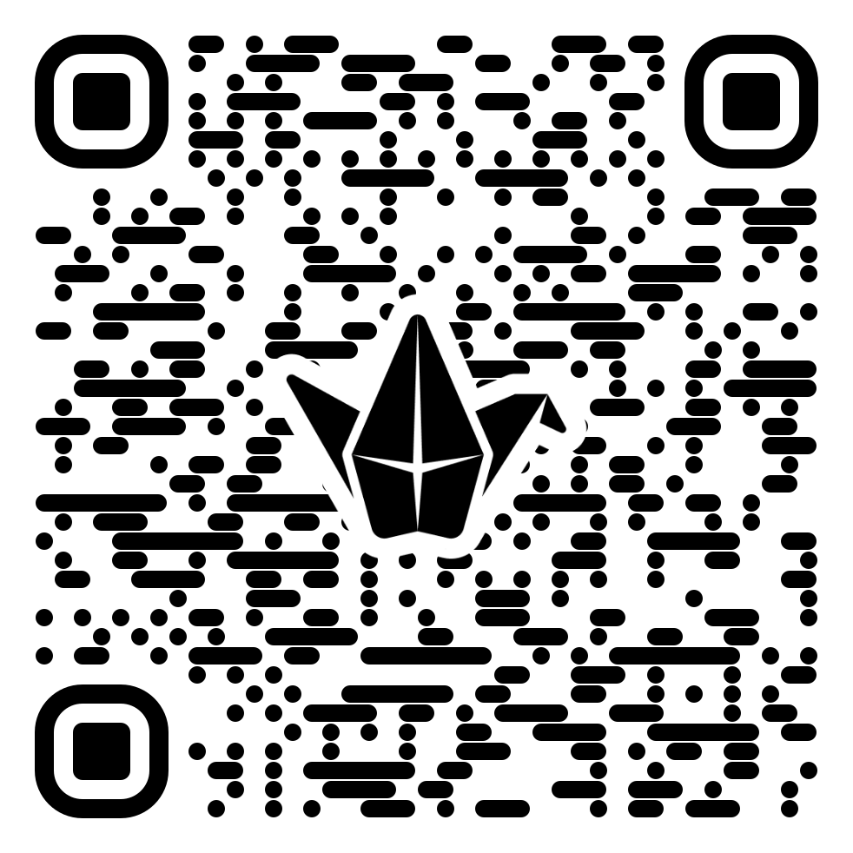

Reflection Discussion
padlet.com/dsykes35/AISymposium
Type your response where it says "Add comment." Click the "+" to add other content, such as a GIF or link
Notes:
We invite you to engage in a reflection discussion by participating in a padlet. If you haven't used padlet before, you will follow a URL and respond to the questions either by typing in a response under the question where it says "Add comment," or by clicking on the plus to add other content types such as GIFs, hyperlinks, or even an AI generated image. I will share my screen and describe the responses as they come in. The link for the padlet is in the chat.

Slide 5
Thank You
CARLI Diversity, Equity, and Inclusion Committee
CARLI Instruction Committee
CARLI Commercial Products Committee
CARLI Discovery Primo VE Committee
CARLI Preservation Committee
Notes:
We are grateful for the support of the CARLI Committees who organized the sessions for today, and thank you to the presenters who volunteered their time and expertise to share exciting projects, practical guidance, and critical questions.

Slide 6
Thank You
CARLI Public Services Committee
CARLI Staff Liaison: Elizabeth Clarage
CARLI Staff Liaison: Amy Maroso
Chair: Kimberly Shotick
Chair: Lesley Wolfgang
Beth Hultman
Jennifer Lau-Bond
Charity Ringel
Gretchen Schneider
Dawn Sterning
Diana Sykes
Simone Williams
Notes:
Finally, the members of the Public Services Committee want to thank you for attending today. We shape the future of AI in libraries together. Look for a survey from CARLI that will help us plan future events, as well as the recordings from today's sessions.

